Slide 1
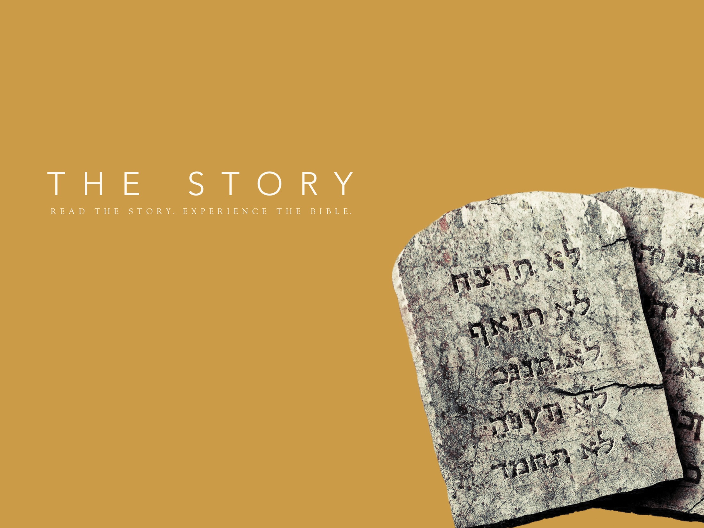
New Commands and a New Covenant
Chapter 5 •
Exodus 19-20; 24-25; 32-34; 40

Slide 2
God reveals himself by His name as “I AM WHO I AM” (Yahweh or Jehovah) which means the self-proclaimed one.
God’s mighty power brought the new nation of Israel out of Egyptian slavery and into freedom.

Slide 3
Remember God’s ultimate passion is to restore relationship!

Slide 4
God gives guidelines for how we treat God and each other. (Exodus 20:1-7)
God wants a community of love that reflects the relationships of the Trinity.
The Ten Commandments shape the community of love.
C. Our sin nature resists God’s guidelines.

Slide 5
God desires a place to dwell among us. Exodus 25
A. God gave specific directions for the making of the Tabernacle. Exodus 25:8-9
B. The Tabernacle was portable tent. God would guide his people with a moving cloud during the day and by a column of fire at night.

Slide 6
God requires that sin be atoned for (covered) by shedding of blood.
Jesus is our great High Priest and his blood once and for all atones for (covers) our sin (Hebrews 10:1-18).
With the blood of Jesus on the door post of our soul, you are forgiven and given direct access into the Most Holy Place.

Slide 7
We are the place where God dwells. We are the new tabernacle.
The Great Commandment is the guideline Jesus gives to and models for us.
The guideline of sacrificial love.

